Slide 1
Slides For Paul
General fnirs stuff
Notes:
<number>

Slide 2
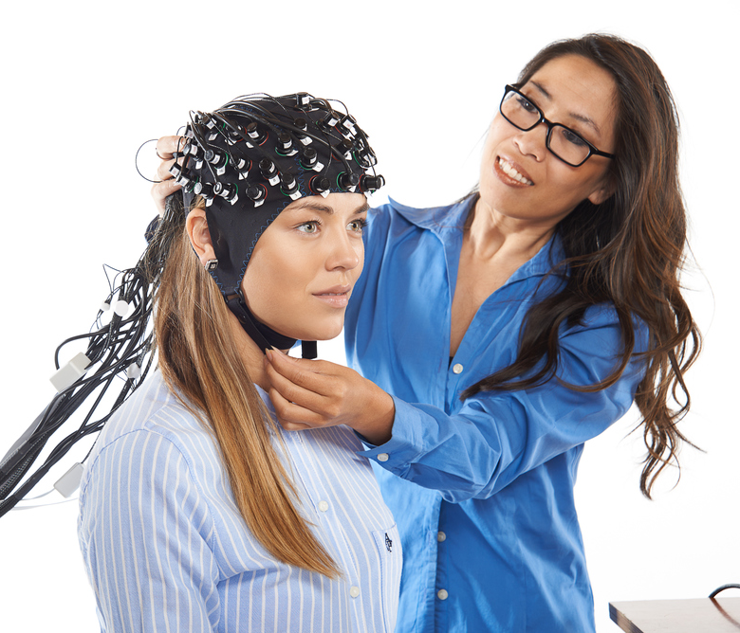
Functional Near-Infrared Spectroscopy
Introduction
Functional Near-Infrared Spectroscopy (fNIRS) is a neuroimaging technique for measuring brain activity.
Uses light which has several benefits:
safe for use in all populations,
not affected by cochlear implant artifacts.
Measures the change in concentration of haemoglobin in blood:
a proxy measure of total local neural activity.
<number>
NIRX Website
Notes:
<number>

Slide 3
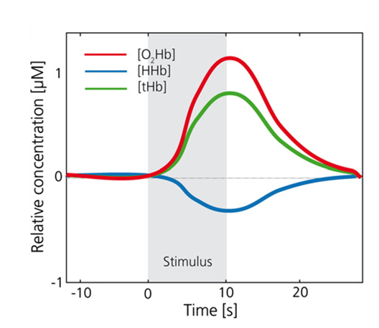
Functional Near-Infrared Spectroscopy
Theory - 1
Your brain needs blood in order to function. Blood carries oxygen and glucose to the brain as fuel for your neurons.
When a region of the brain requires more energy, additional oxygenated blood is pumped to the area.
As your brain uses up the oxygen, the haemoglobin on your red blood cells goes from being oxygenated to de-oxygenated.
By measuring the amount of oxygenated and de-oxygenated blood we have a proxy measurement for brain activity.
Neural activation
↓
Metabolic demand
↓
Increased blood flow/
total haemoglobin
↓
Increase in oxy-haemoglobin
& wash out of deoxy-haemoglobin
Faculty of Human Sciences | Department of Linguistics
<number>
Notes:
Haemoglobin is the specific protein that oxygen binds to on your red blood cells.
<number>

Slide 4
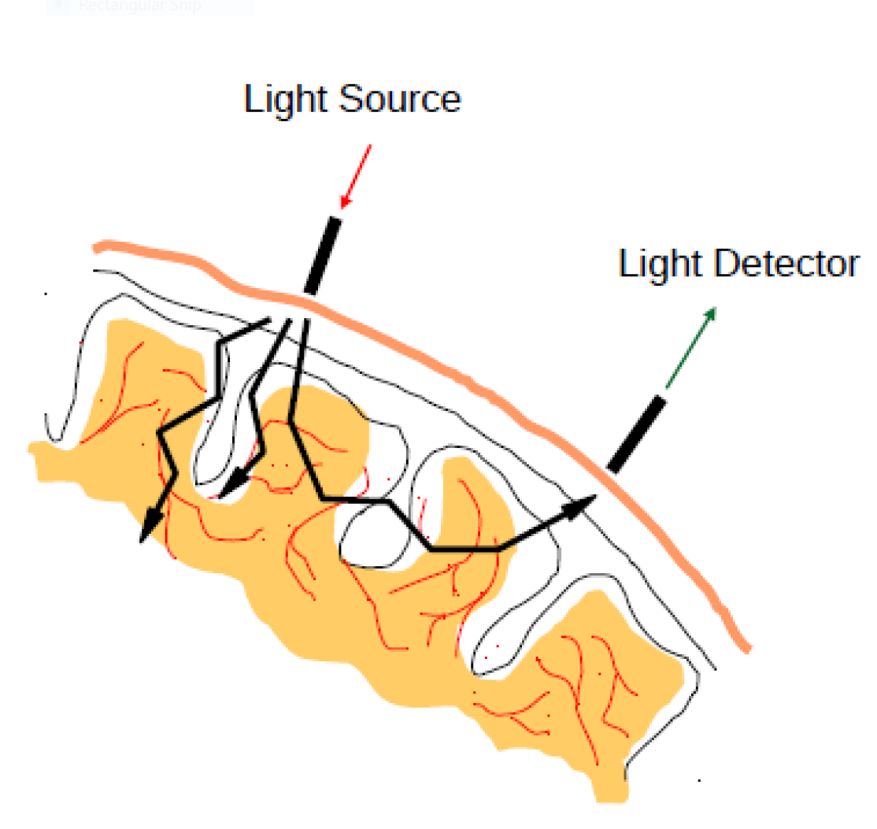
Functional Near-Infrared Spectroscopy
Theory - 2
The light source emits light at two specific wavelengths.
Photons bounce off in all directions and some photons make it back to the detector. Some photons have travelled through the brain, others through the scalp etc.
The two wavelengths are absorbed differently depending on the concentration of oxy- and deoxy-haemoglobin.
We can estimate the change in concentration of oxy- and deoxy-haemoglobin between source and detector.
Faculty of Human Sciences | Department of Linguistics
<number>

Slide 5
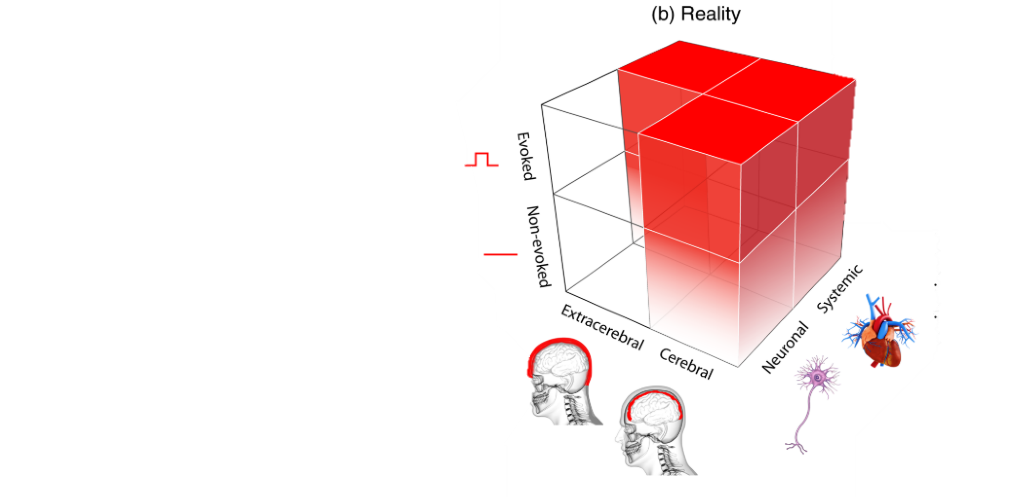
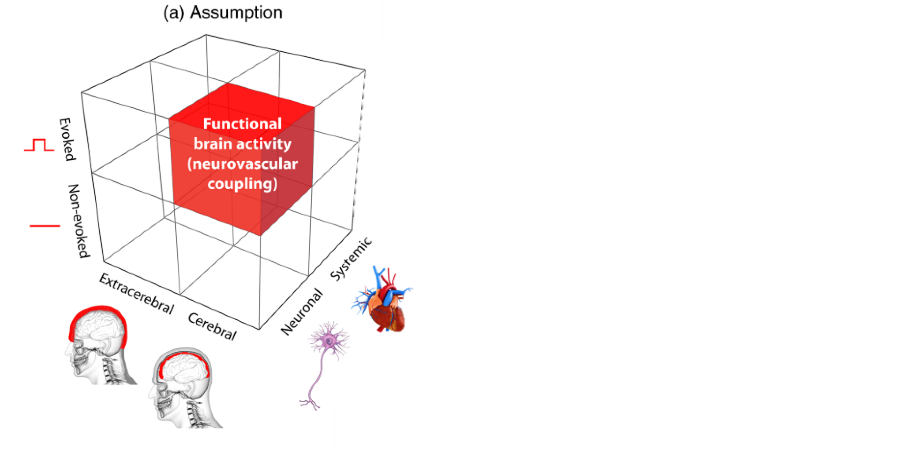
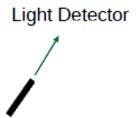
Functional Near-Infrared Spectroscopy
Challenges
Systemic changes can contaminate our signals
Speaking, mental arithmetic, inner speech, etc can cause hanges breathing rate, heart rate…
Need to ensure we estimate only neural activity
Short channel systemic signal rejection
A short channel can measure contributions to the signal from superficial layers.
Use short channels to ensure the response we detect is only reflecting brain activity.
<number>
Tachtsidis & Scholkmann 2015
Notes:
Task-evoked changes in respiration and thus partial pressure
of end-tidal carbon dioxide (PETCO2), a reliable and accurate estimate of the partial pressure of carbon dioxide in the arterial blood (PaCO2), was demonstrated in multimodal fNIRS studies (i.e., fNIRS studies including the measurements of systemic physiological changes using additional monitoring devices) investigating different tasks, e.g., speaking (maximal effect: ΔPaCO2 ≈−9mmHg),6 mental arithmetic (ΔPaCO2 ≈ 0.5 to 3 mm Hg),6,7 and inner speech (i.e., speaking without vocaliza- tion, ΔPaCO2 ≈−0.5 mmHg).8 Task-evoked change in mean arterial blood pressure (ΔMAP)
has been demonstrated for a number of different experimental fNIRS protocols, e.g., arm-raising (ΔMAP ≈6mmHg),9 visual stimulation (ΔMAP ≈2mmHg),10
anagram solving
(ΔMAP ≈ 3 to 5 mm Hg,11,12 6 to 7 mm Hg),13 or hypercapnia (ΔMAP ≈4mmHg),14 hypocapnia (ΔMAP ≈ 4.5 mmHg;14 ΔMAP≈−10 mmHg),15 hypoxemia (ΔMAP ≈2mmHg),15 and hyperoxia (ΔMAP ≈2mmHg).1
Uses light which has several benefits:
Safe for use in all populations
Resistant to muscle artifacts (blinking, movement, etc)
Not affected by cochlear implant artifacts
Only measures shallow depth
But also has several drawbacks:
Difficult to separate systemic and neural activity
Analysis and interpretation is challenging
Only measures shallow depth
<number>

Slide 6
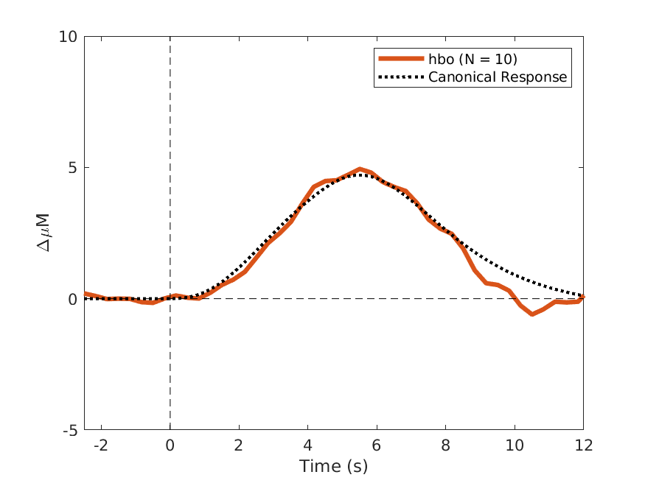
Appendix
fNIRS analysis and model fit
Data was whitened before a general linear model (GLM) was used fit a canonical response (4.5 s peak time based on pilot) for each subject and condition
This approach overcomes several issues
fNIRS noise is correlated
Each sample point is not independent
Measurement channels are not independent
Both artifacts and optical wavelengths have strong spatial structure
Outstanding issues
Data is nonergodic and non stationary
Noise and systemic physiology changes over length of scan
Grand average (N = 10) including all conditions
Faculty of Human Sciences | Department of Linguistics
<number>
Huppert 2016 Barker et al 2013
Notes:
Samples not independent : Effective linear model degrees of freedom is less than the number of samples
Channels not independent: affects group level analysis and region of interest analysis
Non stationary: no easy solution. Dynamc estimation models are complicated
https://ourcodingclub.github.io/2017/03/15/mixed-models.html
<number>

Slide 7
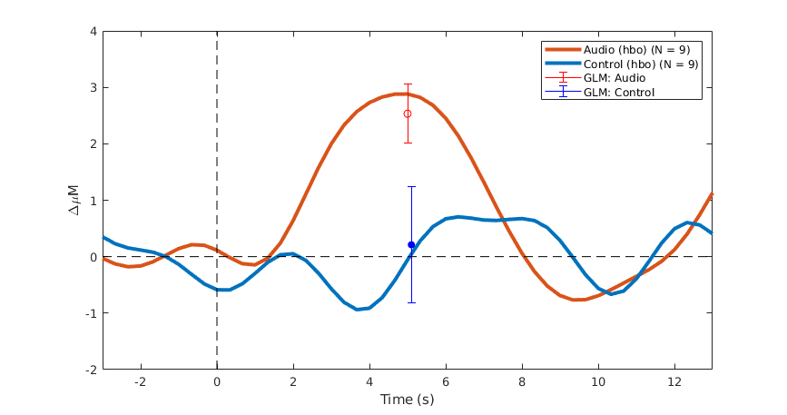
Analysis Methods
Group comparison
Data from all participants and conditions were combined to create a grand average waveform
Resample (3 Hz)
Bandpass filter (0.05 – 0.6 Hz)
Extract epochs and detrend
Average all epochs
AR-IRLS GLM method also applied
Provides estimate of amplitude
Averaging estimate lies within GLM standard error
Faculty of Human Sciences | Department of Linguistics
<number>
Huppert 2016 Barker et al 2013
Notes:
<number>

Slide 8
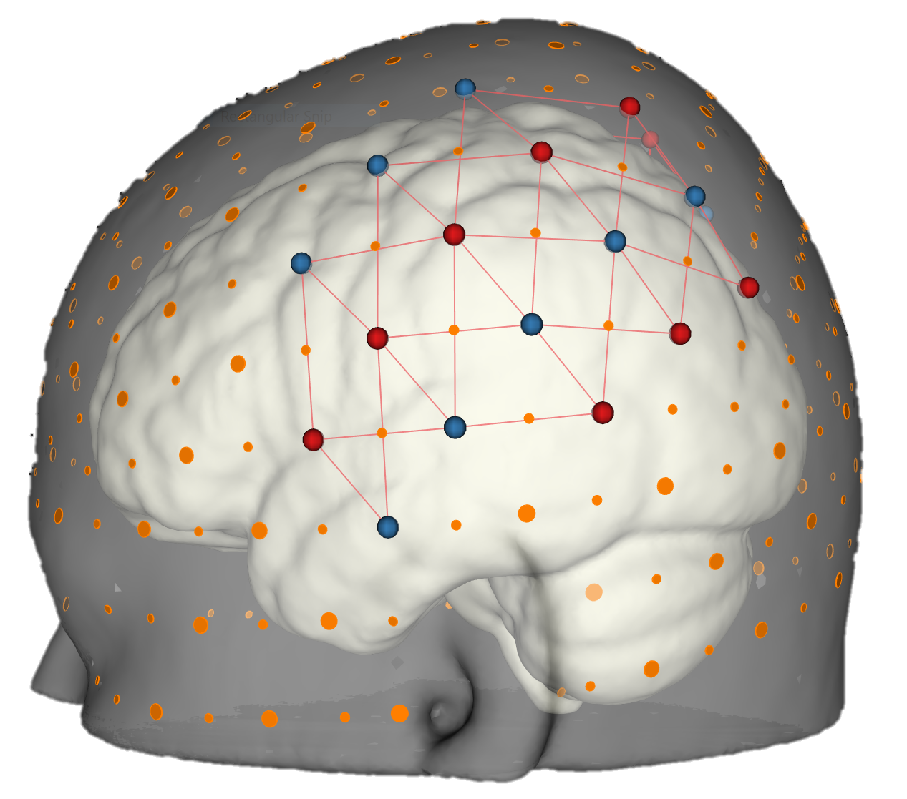
Methods
Imaging Details
Seated in a dimly lit room watching a silent subtitled movie
Participants are asked not to pay attention to sounds or gaps
16 source and 16 detectors cover our region of interest
7 Hz sampling rate
Faculty of Human Sciences | Department of Linguistics
<number>

Slide 9

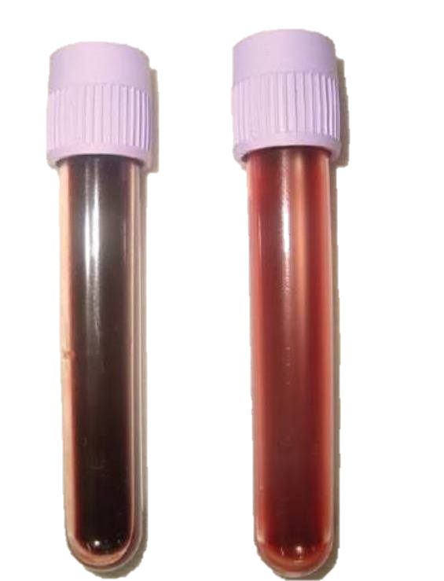
Background
Functional Near-infrared spectroscopy - Theory
Your brain needs blood in order to function. Blood carries oxygen and glucose to the brain as fuel for your neurons.
Haemoglobin is the specific protein that oxygen binds to on your red blood cells.
When a region of the brain requires more energy, additional oxygenated blood is pumped to the area.
As your brain uses up the oxygen, the haemoglobin on your red blood cells goes from being oxygenated to de-oxygenated.
By measuring the amount of oxygenated and de-oxygenated blood we have a proxy measurement for brain activity.
Faculty of Human Sciences | Department of Linguistics
<number>
Notes:
Dark =
Light =
https://www.google.com/search?client=firefox-b-ab&biw=1813&bih=885&tbm=isch&sa=1&ei=RXSoW-fBC4_dhwPEmpegDw&q=oxygenated+blood+deoxygenated+blood+vial&oq=oxygenated+blood+deoxygenated+blood+vial&gs_l=img.3...132479.133618.0.133821.5.5.0.0.0.0.269.510.2-2.2.0....0...1c..64.img..3.2.508...0i30k1j0i8i30k1.0.s3XuAWkVEYc#imgrc=fsZodStI9JTIbM:
<number>

Slide 10
Background
Functional Near-infrared spectroscopy - Theory
The light source emits light at two specific wavelengths (760 and 850 nm at Macquarie University)
Photons bounce off in all directions and some photons make it back to the detector. Some photons have travelled through the brain, others through the scalp etc.
The two wavelengths are absorbed differently depending on the concentration of oxy- and deoxy-haemoglobin
We can estimate the concentration of oxy- and deoxy-haemoglobin between source and detector
Faculty of Human Sciences | Department of Linguistics
<number>

Slide 11
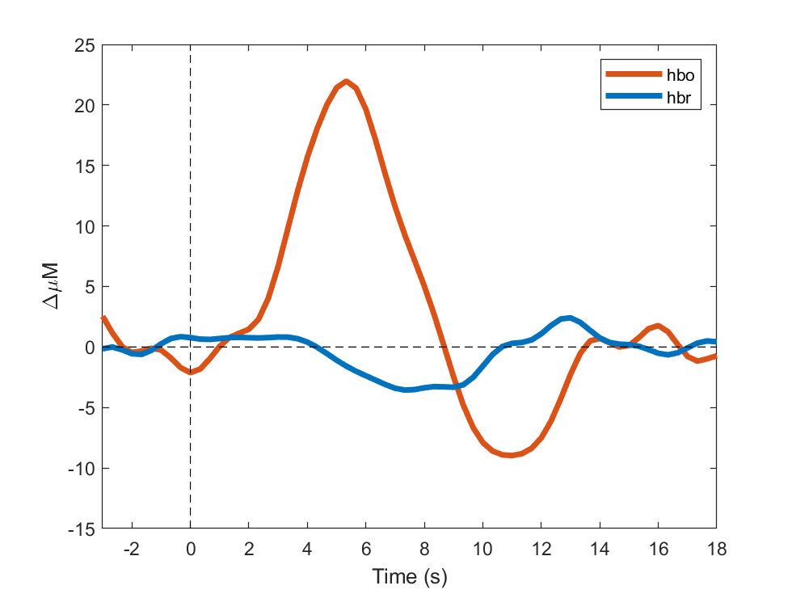
Background
Functional Near-infrared spectroscopy - Theory
Neural activation
↓
Metabolic demand
↓
Increased blood flow
↓
Increase in oxy-haemoglobin
& wash out of deoxy-haemoglobin
<number>
Notes:
<number>

Slide 12
Background
Functional Near-infrared spectroscopy - Theory
Benefits:
Easy and child friendly
Safe and cochlear implant compatible
Drawbacks:
Only measures changes in concentration between conditions
Only measures outer regions of the brain
Easily contaminated by systemic changes
between two conditions
Affected by systemic changes
Depth
Faculty of Human Sciences | Department of Linguistics
<number>

Slide 13
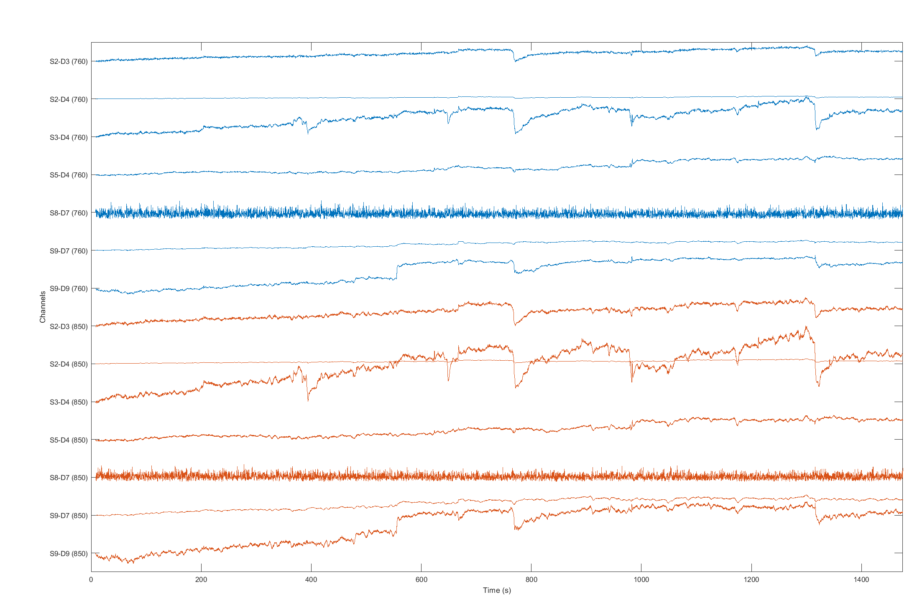
Methods
Data Analysis
For each recording the Beer-Lambert law is applied to determine the oxy- and deoxy- haemoglobin concentration. The data is then whitened to remove artifacts.
For each channel and condition a canonical model is generated based on the trigger timing. A GLM is then used to estimate the parameters of the response function per subject x channel x condition.
Group level analysis is then conducted on the subject level analysis. A GLM is used to determine the effect each condition has on the change in haemoglobin concentration.
Faculty of Human Sciences | Department of Linguistics
<number>
Huppert 2016 Barker et al 2013
Notes:
Samples not independent : Effective linear model degrees of freedom is less than the number of samples
Channels not independent: affects group level analysis and region of interest analysis
Non stationary: no easy solution. Dynamc estimation models are complicated
<number>

Slide 14
Results
Analysis procedure
Initial analysis determined a significant response when data from all participants and conditions were combined
Verified that the canonical response used in GLM analysis is a good fit for our data
Analysis confirmed that each participant had a significant response when all conditions were combined
Applied GLM analysis using canonical response to each condition for each subject
Grand average (N = 10) including all conditions
Faculty of Human Sciences | Department of Linguistics
<number>
Huppert 2016 Barker et al 2013
Notes:
Samples not independent : Effective linear model degrees of freedom is less than the number of samples
Channels not independent: affects group level analysis and region of interest analysis
Non stationary: no easy solution. Dynamc estimation models are complicated
<number>

Slide 15
Example Measurement (Raw Data)
Synchronised artifact across channels
Noisy channel
Single channel artifact
Spike artifact

Slide 16
Example Condition Averaged Response (Auditory)
Auditory experiment
Single source-detector pair
Single (exemplary) participant
60 trials (45 minutes)
Thin lines represent individual trials
Thick lines are average across all trials
Dashed lines are start and stop of stimulus
HRF response observed

Slide 17
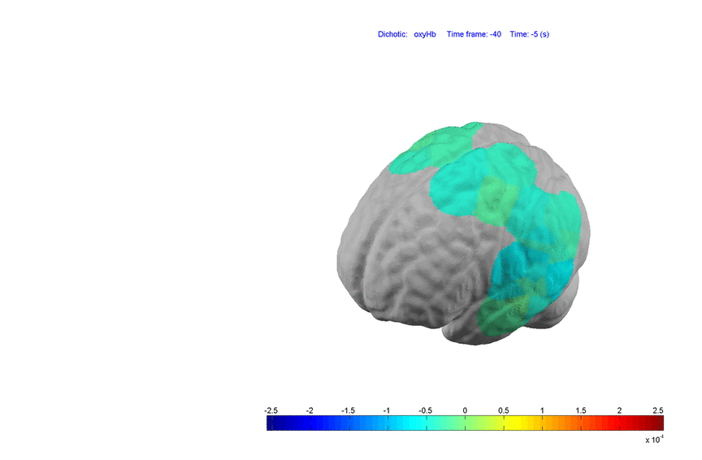
Example Temporospatial Structure
Motor based task
Expected HRF peak at 5 seconds
Expected response in motor cortex
Color represents ΔuM in oxyHb

Slide 18
Near-Infrared Spectroscopy
Theory
Your brain needs blood in order to function. Blood carries oxygen and glucose to the brain as fuel for your neurons.
Haemoglobin is the specific protein that oxygen binds to on your red blood cells. As your brain uses up the oxygen, the haemoglobin on your red blood cells goes from being oxygenated to de-oxygenated.
By measuring the amount of oxygenated and de-oxygenated blood we have a proxy measurement for brain activity.
<number>

Slide 19
Near-Infrared Spectroscopy
Theory
Light source emits light at two specific wavelengths (760 and 850 nm at Macquarie University)
Photons bounce off in all directions and some photons make it back to the detector
The two wavelengths are absorbed differently depending on the concentration of oxy- and deoxy-haemoglobin
Can estimate the concentration of oxy- and deoxy-haemoglobin between source and detector
<number>

Slide 20
Near-Infrared Spectroscopy
Theory
Neural activation
↓
Metabolic demand
↓
Increased blood flow
↓
Increase in oxy-haemoglobin
& wash out of deoxy-haemoglobin
<number>
Notes:
<number>

Slide 21
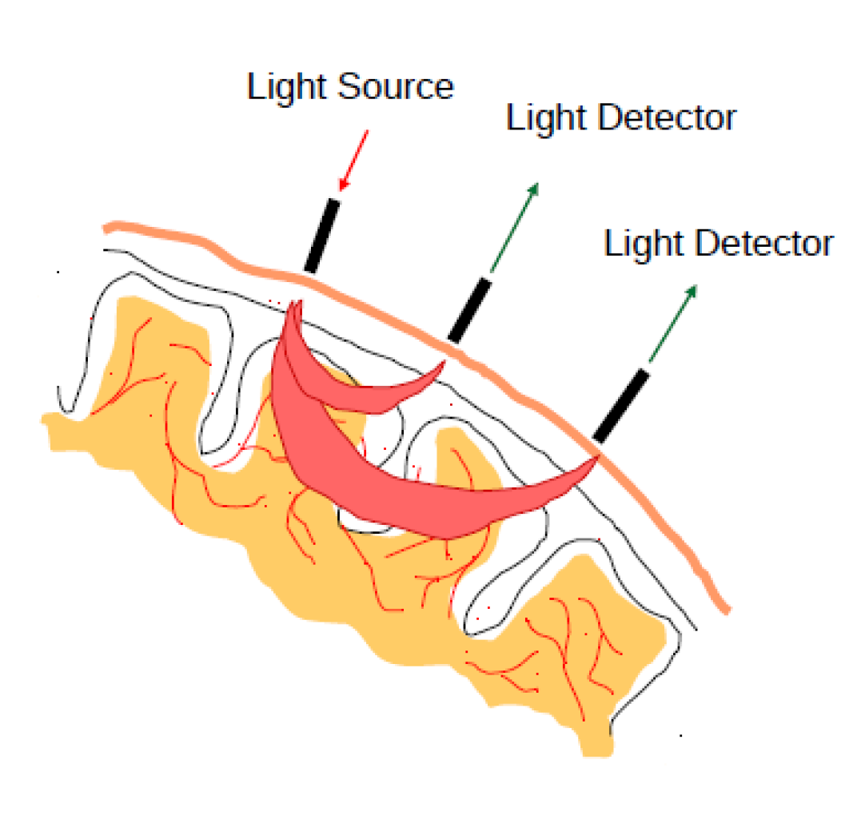
Near-Infrared Spectroscopy
Advanced techniques
Short channel recordings
The depth of probed tissue is related to spacing between light source and detector
A short channel can measure contributions to the signal from superficial layers
Remove short channel information from long channel to leave only information from target depth
<number>

Slide 22
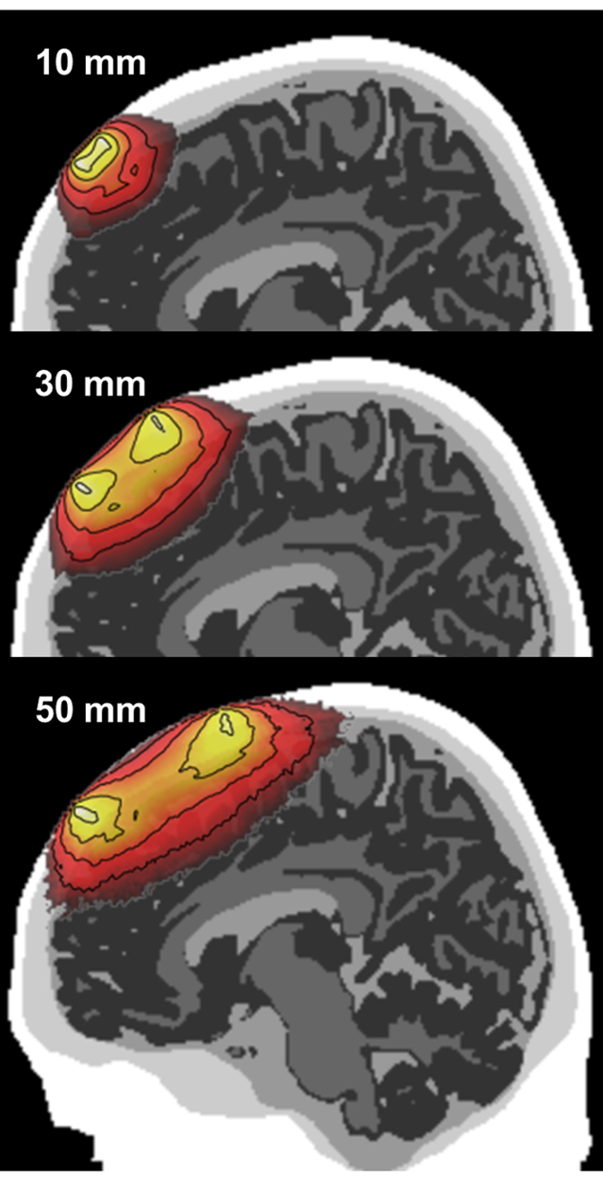
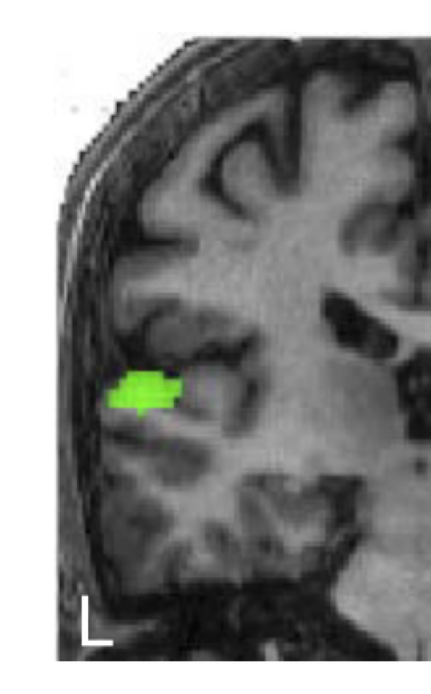
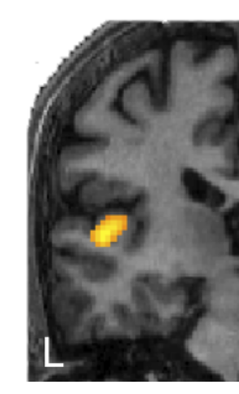
Near-Infrared Spectroscopy
Advanced techniques
Multi depth analysis – towards tomography
Modify spacing of source detectors to probe different depths
Challenging as the number of photons returning to detector decreases exponentially with depth
With many sensors (24x2 at Macquarie Uni) you can probe multiple locations and depths
<number>
Notes:
http://journals.plos.org/plosone/article?id=10.1371/journal.pone.0066319 Depth sensitivity colin 27 2013
<number>

Slide 23
Near-Infrared Spectroscopy
Benefits and drawbacks
Benefits
Easy to set up and child friendly
More accessible than MRI & MEG
More robust than EEG to movement
Only probes outer brain
Can be used at the same time as other methods (EEG)
No electrical artifacts from cochlear implants
Drawbacks
Only probes outer brain
Less temporal resolution than EEG
Less spatial resolution that MRI
<number>

Slide 24
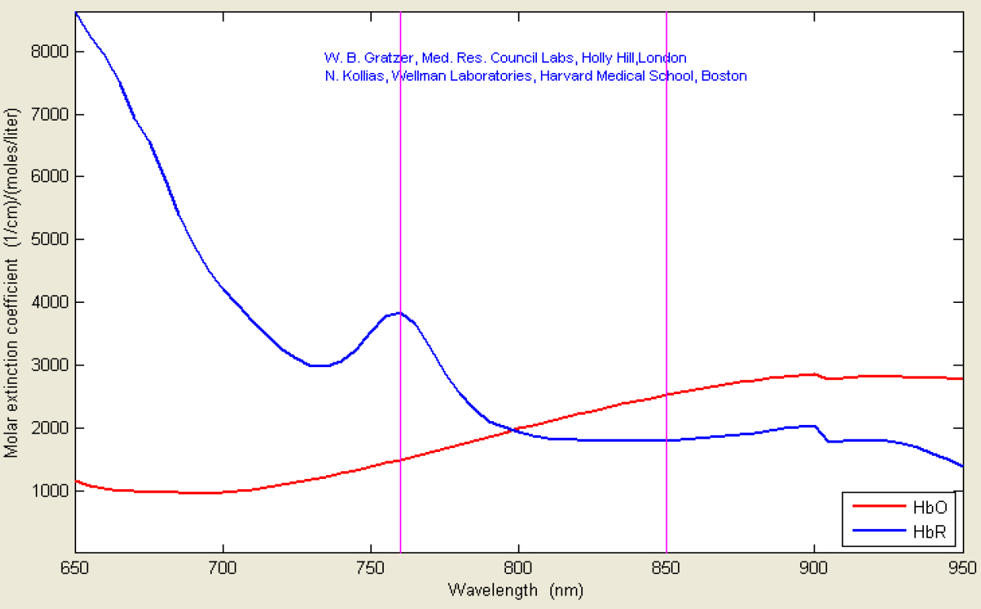
Haemoglobin Absorption Spectra
Determine Concentration from Signals
<number>
Notes:
‘Molar extinction coefficients’ are known parameters defining how strongly a substance absorbs light at a given wavelength
<number>

